Slide 1
Problem Solving
How to teach our children to be successful….
and it’s ok if they’re not!
Presented by Katie Taylor & Michelle Winn

Slide 2
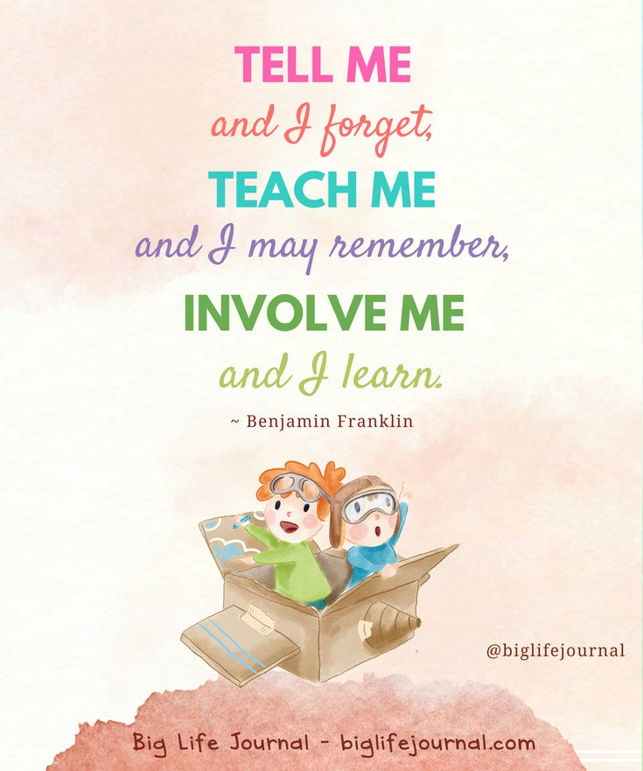

Slide 3
Kids get stuck!
https://www.youtube.com/watch?v=DBPTzA6mxCw
Lets teach them how to be successful problem solvers.
This creates confident, independent, and successful children.
Kids with good problem solving skills are more creative, manage emotions better, and are persistent.

Slide 4
Problem Solving Steps
What are you feeling?
What is the problem?
What are solutions?
What would happen if...
Which one will I try?

Slide 5
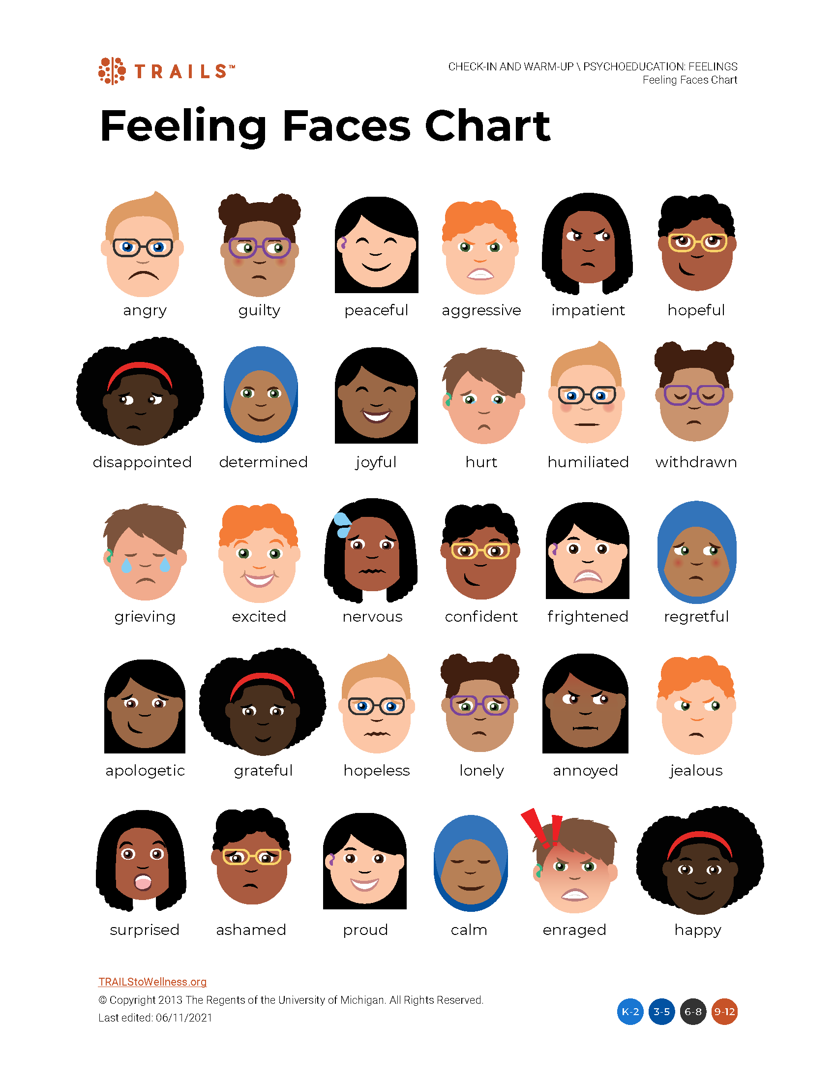
1. What are you feeling?
Help your child take a step back and calm down
Have visual of feelings
https://trailstowellness.org/materials/cbt-and-mindfulness-groups/resources/psychoeducation-feelings
Allow your child to verbalize how they are feeling
Validate feelings
I understand that you’re upset because Jack took your candy.
It’s ok to have different feelings! It’s how we react that matters.

Slide 6
2. What is the problem?
Identify the specific problem
What is the hard part?
Have your child take responsibility for what they did
Don’t point fingers!
Instead of Paul got me in trouble for talking in class, state I got in trouble for talking to Paul in class.

Slide 7
2. What are the solutions?
Don’t give them the answers
Brainstorm with them
Come up with as many solutions as possible
Let them be creative
Discuss what you can control and what you can’t

Slide 8
4. What would happen if…
Weigh the pros and cons
Is the solution fair?
Is the solution safe?
How will it make others feel?
Role play!

Slide 9
5. Which one will I try?
Pick as many as needed
If the solution doesn’t work, discuss why and try another one.
It’s ok to make mistakes!
We learn from failures

Slide 10
Ask open ended questions to help with problem solving or to practice thinking skills
How could we work together to solve this?
How do you know that?
Tell me about what you created.
What do you think will happen next?
What did you learn?
What was easy? What was hard?
What would you do differently next time?

Slide 11
Break the Problem into Chunks
Example: failing a class
Missing assignments?
Distracted in class?
Low test grades?
Not studying?
Tackle each smaller problem individually

Slide 12
Model Problem Solving
Think out loud when you have a problem
Make mistakes and tell them it’s ok!
Ask your child for advice
Working together makes them feel valued
Example: late baseball practice, what to do for dinner?

Slide 13
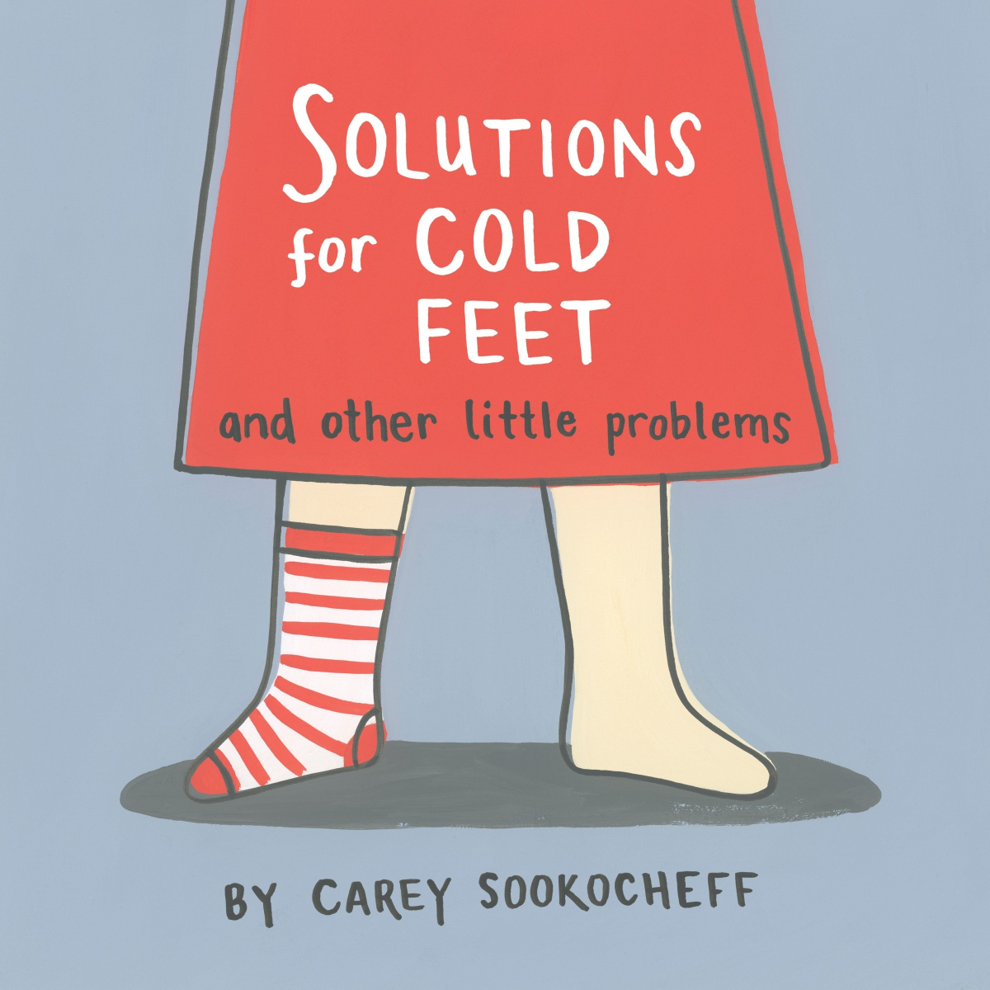
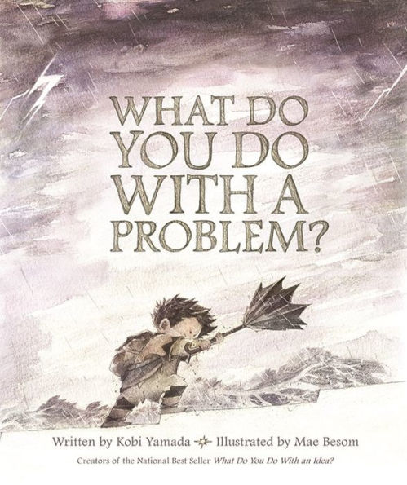
Books to Read

Slide 14
More Ideas
Use a graphic organizer: https://static01.nyt.com/images/blogs/learning/pdf/2010/20101025problemsolvechart.pdf
Give your child paper clips, cotton balls, straws, popsicle sticks, sticky notes, tape, yarn, etc. and have them create a leprechaun trap, ramp for cars, game, or device for communication
Play chess
Learn to code

Slide 15
References
https://biglifejournal.com/blogs/blog/how-teach-problem-solving-strategies-kids-guide
https://trailstowellness.org/materials/cbt-and-mindfulness-groups/resources/psychoeducation-feelings
https://tinkergarten.com/blog/books-that-help-us-teach-problem-solving

